Slide 1
Minor Project title:
Design of Tic-Tac-Toe game using
Game Tree searching approach
Presented By:-
Ruchi Gupta
Roll no: CA-M1504
MCA – 5th semester
Majuli Koch
Roll no:- CA-M1512
MCA – 5th semester
Project guide: Rubul Kumar Bania
Asst. Professor, Department Of Computer Application, N.E.H.U, Tura Campus

Slide 2
CONTENTS
Introduction
Objectives
About Mini-Max & Alpha-Beta
Present Status
References

Slide 3
INTRODUCTION
In the area of today's technology, Game playing is a terminology, where a game is played in between a human and a computer.
The advances in this field with artificial intelligence finally allowed computers to win humans in most complex games.
Game playing, besides the topic of attraction to the people, has close relation to intelligence, and its well defined states and rules.
The most commonly used AI technique is “Search”.

Slide 4

ZERO-SUM GAME
It is a game where the interests of the players are opposed. Regardless of the outcome of the game, the winnings of the player(s) are exactly balanced by losses of the other(s). So net change in wealth or benefit is zero. A zero-sum game is also called a strictly competitive game .
Tic-Tac-Toe is a zero-sum game for two players (X and O) who take turns marking the spaces in a 3×3 grid. The following are the rules of the game:

Slide 5
OBJECTIVES OF THE PROJECT
To implement algorithms like MiniMax, NegaMax and Alpha-Beta pruning.
To propose a new static evaluation function and to evaluate it.
To represent a comparative analysis among the three algorithms.
To provide a user friendly GUI for playing the game.

Slide 6
MiniMax Algorithm
The mostly used game tree search algorithm is the MiniMax algorithm.
The theory behind MiniMax is that the algorithm's opponent will be trying to minimize whatever value the algorithm is trying to maximize (hence, "minimax"). Thus, the machine should make the move which leaves its opponent capable of doing the least damage or less chance of win.

Slide 7
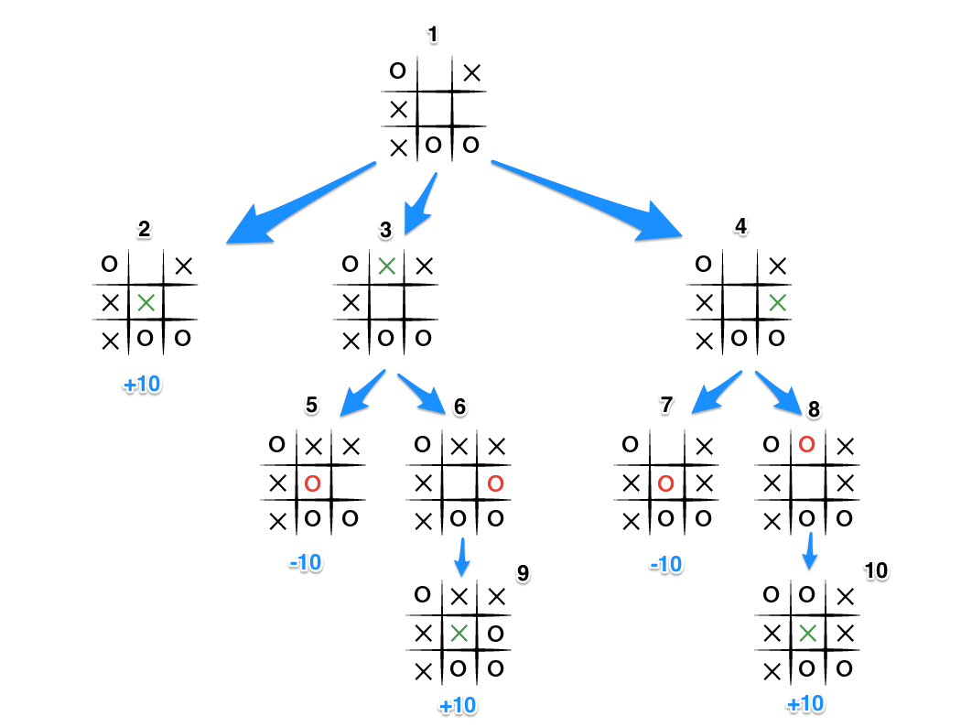

Slide 8
Alpha-Beta cutoffs
Alpha-beta cutoffs is an improvement over the minimax algorithm.
It is possible to compute the correct minimax decision without looking at every node in the tree.
While using MiniMax, situations may arise when search of a particular branch can be safely terminated. So, while doing search, figure out those nodes that do not require to be expanded.

Slide 9
Max-player cuts off search when it knows Min-player can force a provably bad outcome.
Min-player cuts off search when it knows Max-player can force a provably good outcome.
Applying and Alpha-beta cutoff means we stop search of a particular branch because we see that we already have a better opportunity elsewhere

Slide 10
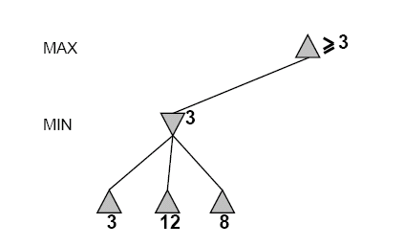
α, β, initial values
α=−∞
β =+∞
α, β, passed to kids
α=−∞
β =+∞

Slide 11
α=−∞
β =+∞
α=−∞
β =3

Slide 12
α=−∞
β =+∞
α=−∞
β =3
MIN updates β, based on kids.
No change.

Slide 13
MAX updates α, based on kids.
α=3
β =+∞
3 is returned
as node value.

Slide 14
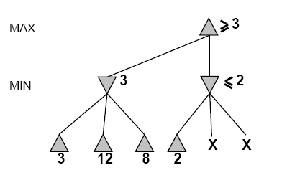
α=3
β =+∞
α, β, passed to kids
α=3
β =+∞

Slide 15
α=3
β =+∞
α=3
β =2
α ≥ β,
So,
cutoff.

Slide 16
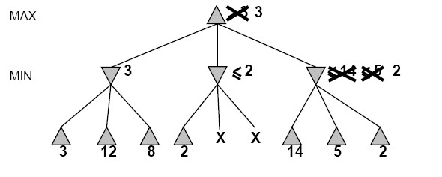
2

Slide 17
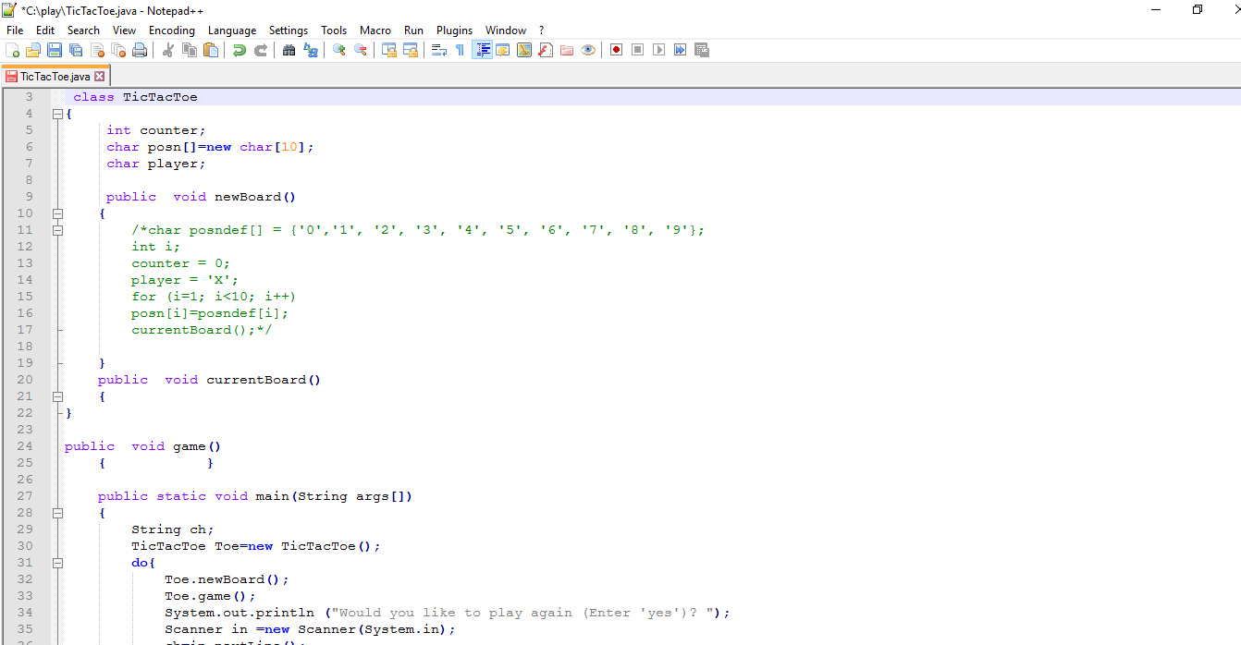
Present Status

Slide 18
References
A.A. Elnaggar, M.A.Aziem and M.Gadallah, A Comparative Study of Game Tree Searching Methods. International Journal of Advanced Computer Science and Applications. Vol.5,No.5, pp.68-77, 2014.
Magnuson, Max (2015) "Monte Carlo Tree Search and Its Applications," Scholarly Horizons: University of Minnesota, Morris Undergraduate Journal: Vol. 2: Iss. 2, Article 4,pp.1-7.
AI Principles, Nilsson, chapter 3
Book- AI, Rich & Knight

Slide 19
THANK YOU ALL

